Slide 1
Coding Club 2022

Slide 2
About Me
2nd Class (Junior Year) Engine Cadet. B.E. Naval Architecture. Some coding experience with some programs:
Arduino IDE
Python
Scratch
Some Projects I have worked on:
Prime Number Finder (Python)
Class Registration Tool (Python)
Microgravity Washing Machine (Hardware/Arduino/Raspberry Pi)
Various Video Games (Scratch)

Slide 3
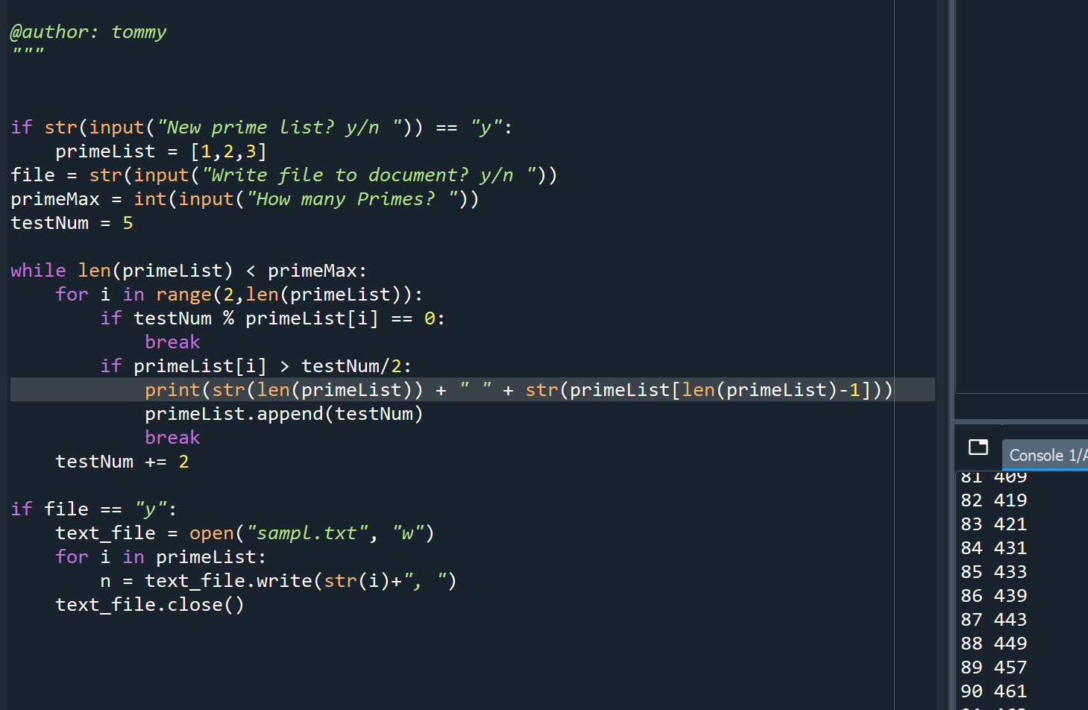
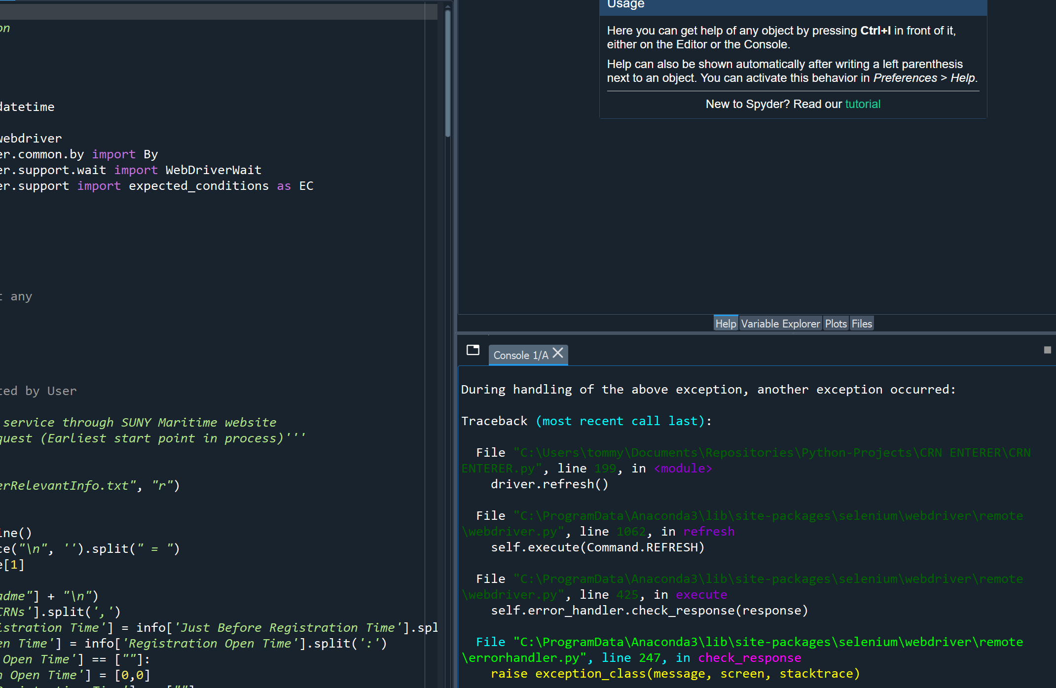
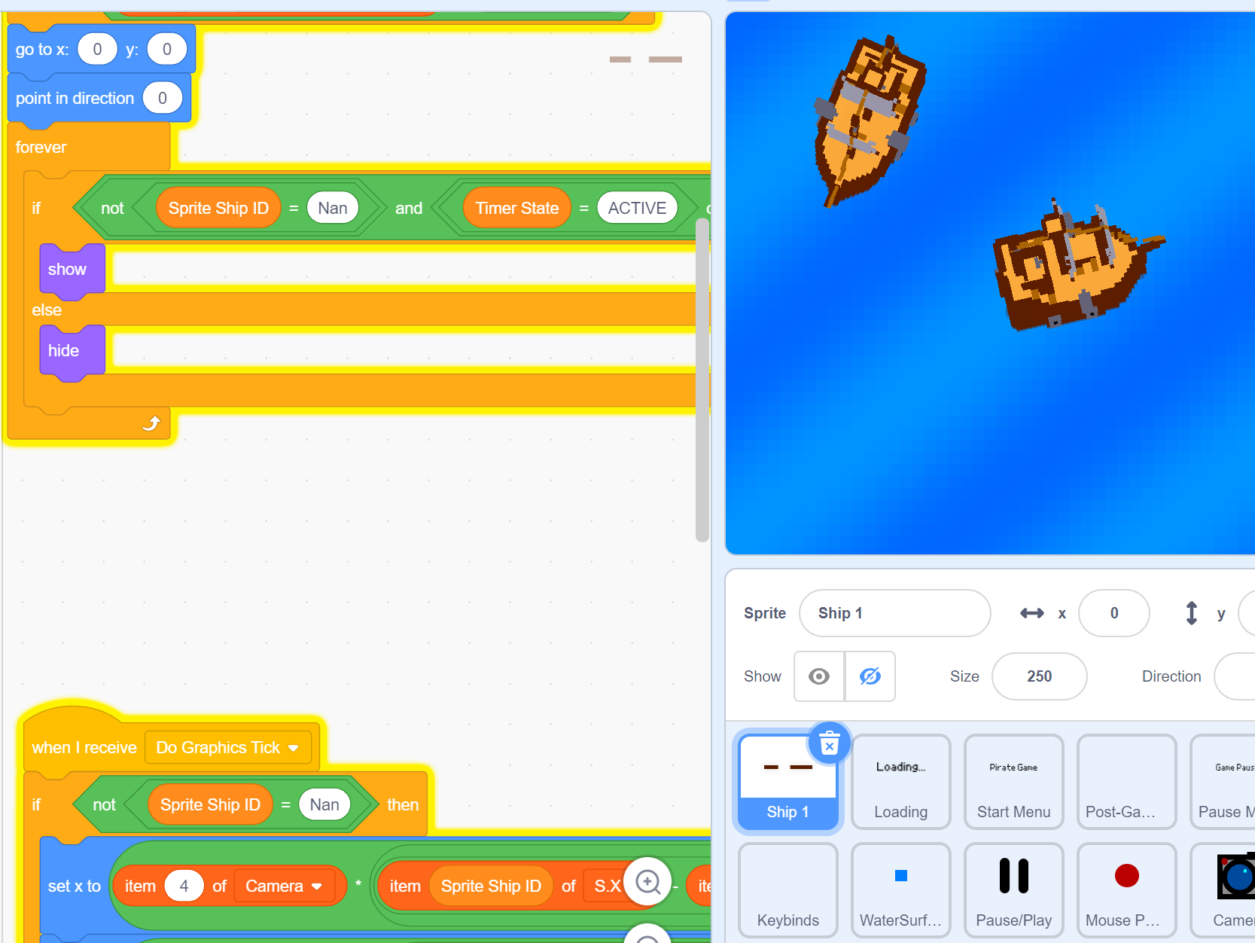
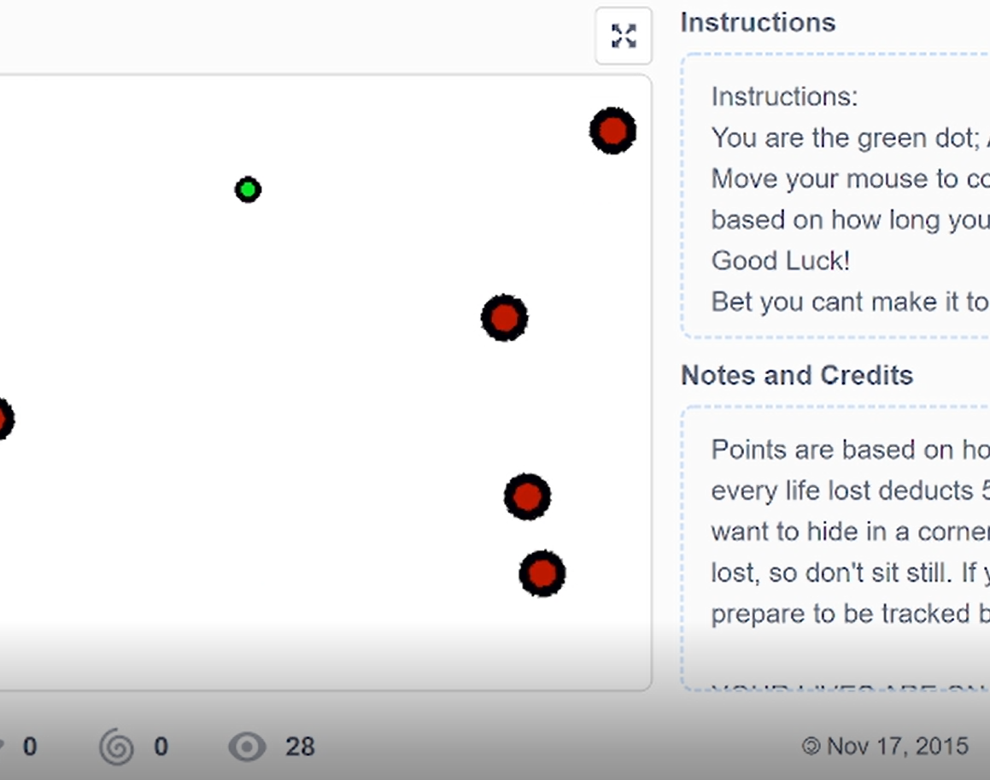
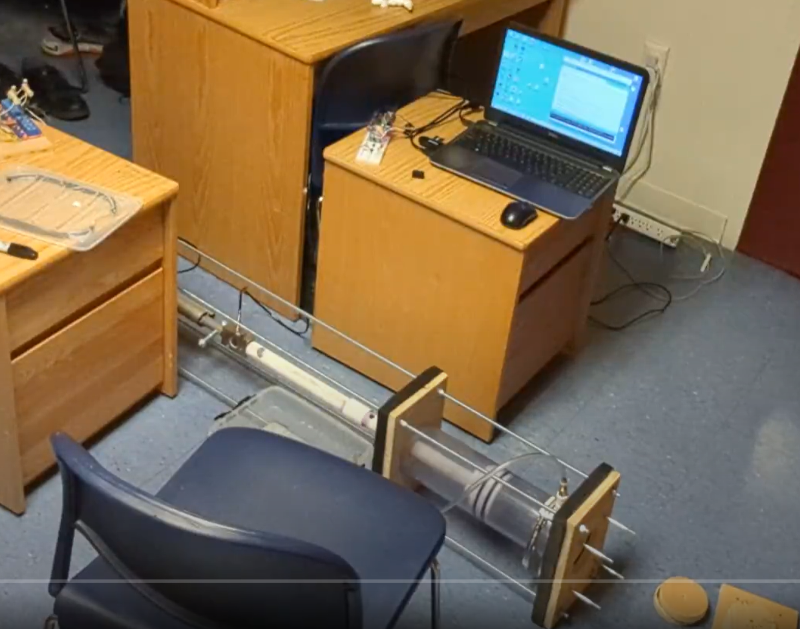

Slide 4
About the Club
A place to get together and share projects, work together, and work on various projects involving coding in any capacity.
Have a network of people to work with, discuss ideas, and further their learning for coding applications.
Use this club as a platform and excuse to work on that one project you’ve been wanting to do

Slide 5

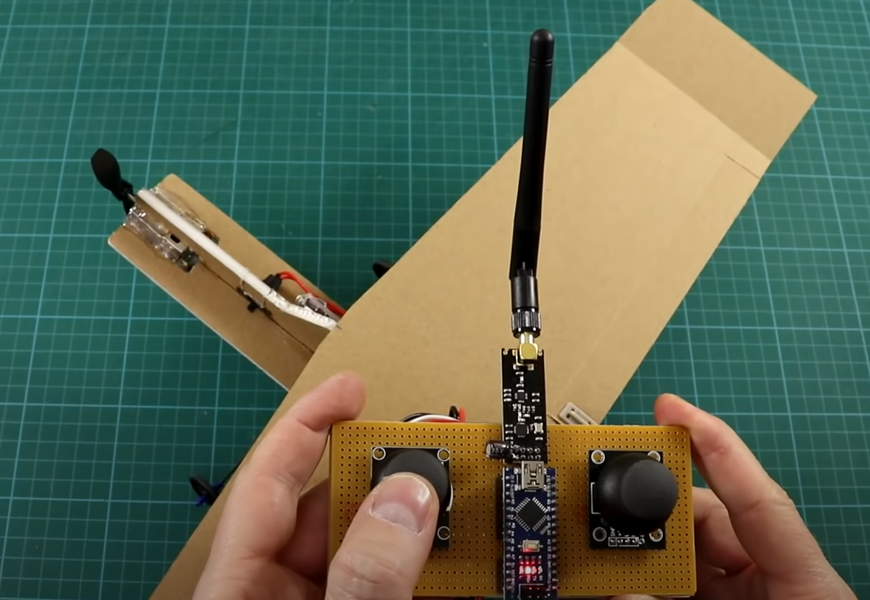
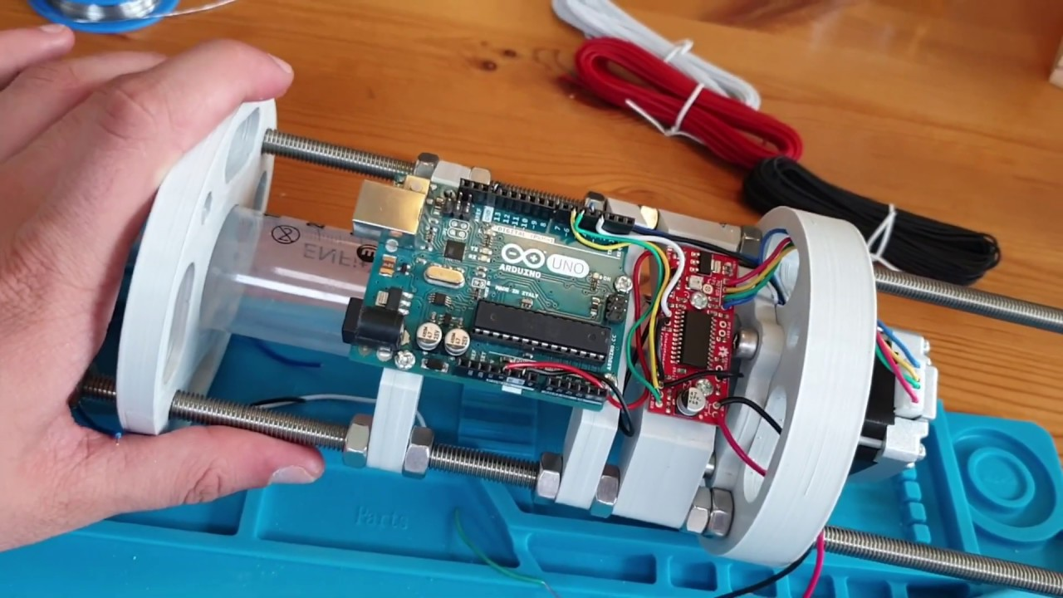
Plans for this year
Club Wide Project: Scratch Video Game
Start today
Everyone can be involved
Low time investment for experienced coders
Great way to learn coding principles
Specialized Projects
Arduino and other hardware related projects
Data Science and machine learning related projects

Slide 6
Club Events
No Club Events Planned. Possible events:
Game Jam
Maker fair
Open for Suggestions

Slide 7
Thank You for Coming! Any questions or comments?

Slide 8
Join the Porthole!
Tommy Rohmann, Club President
Thomasroh.20@sunymaritime.edu
443-847-4657
Alice Kwon, Club Advisor
akwon@sunymaritime.edu

